Slide 1

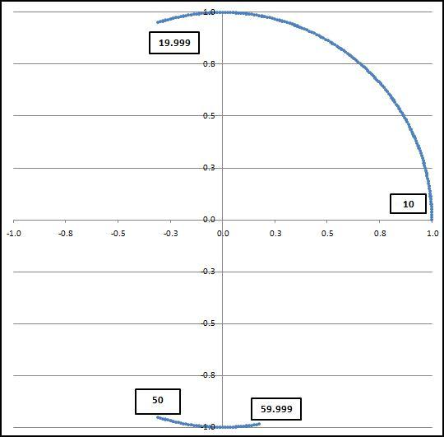
Chapter 6
One digit at a time
All digits together
Logarithmic basis of Benford’s Law
Creating a Benford Set
Prepared by:
Mark J. Nigrini
Copyright © 2012 by Mark J. Nigrini. All rights reserved.
Notes:
Pages 109 to 129.
Testing conformity to Benford’s Law. Preferred test is the Mean Absolute Deviation (MAD) test.

Slide 2
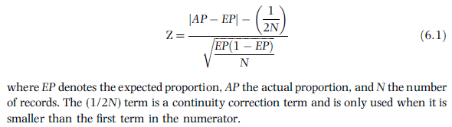
one digit at a time
Notes:
Pages 110 to 111.
The Z-statistic is used to test whether the actual proportion for a specific first-two digit combination differs significantly from the expectation of Benford's Law. The formula takes into account the absolute magnitude of the difference (the numeric distance from the actual to the expected), the size of the data set, and the magnitude of the expected proportion.
The Z-statistics cannot be added or combined in some other way to get an idea of the overall extent of nonconformity.

Slide 3
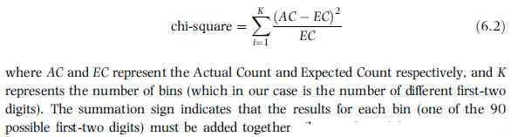
all digits together
Notes:
Pages 111 to 114.
The chi-square test is often used to compare an actual set of results with an expected set of results. In this case our expected result is that the data follows Benford's Law. The null hypothesis is that the first two digits of the data follow Benford's Law.
The calculated chi-square statistic is compared to a cutoff value which can be calculated in Excel by using the CHIINV function. For example, CHIINV(0.05,89) equals 112.02. If the calculated chi-square value exceeds 112.02 then the null hypothesis of conformity of the first-two digits must be rejected and we would conclude that the data does not conform to Benford's Law.

Slide 4
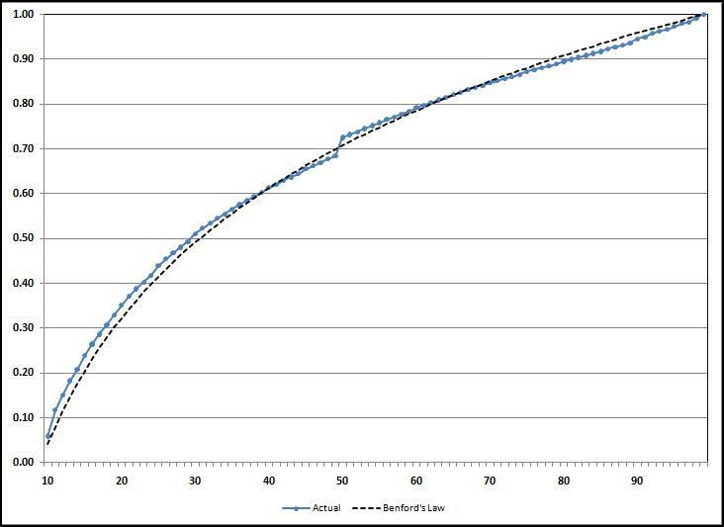
all digits together
Notes:
Pages 111 to 114.
Figure 6.1.
Another "all digits at once" test is the Kolmogorov-Smirnoff (abbreviated K-S) test. This test is based on the cumulative density function.
The K-S test takes the largest of the absolute values of these ninety possible first-two digit differences (called the supremum in statistical terms). The formula to determine whether the result is significant is shown in equation 6.3.

Slide 5
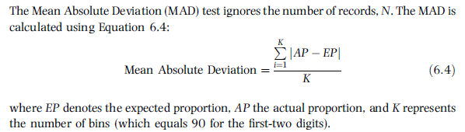
mean absolute deviation
Notes:
Pages 114 to 115.

Slide 6
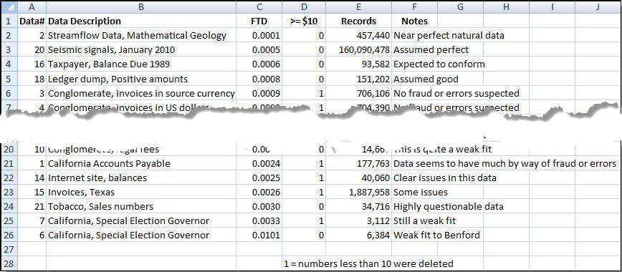
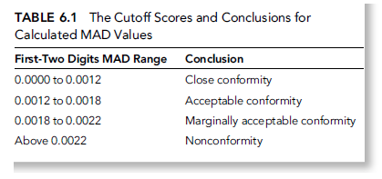
mad cutoff values
Notes:
Page 115.
Figure 6.2 has been cropped in the center.

Slide 7
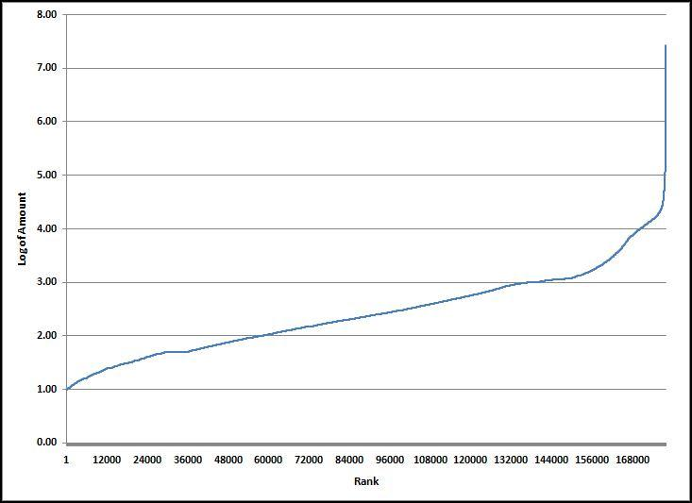
logarithmic foundation
Notes:
Pages 115 to 121.
Figure 6.5.
The ordered (ranked from smallest to largest) logs are expected to form a straight line.
Because Excel can only graph 32,000 points we might need to take a random sample of the logs to see what they look like on a graph. See Figures 6.3 and 6.4.

Slide 8
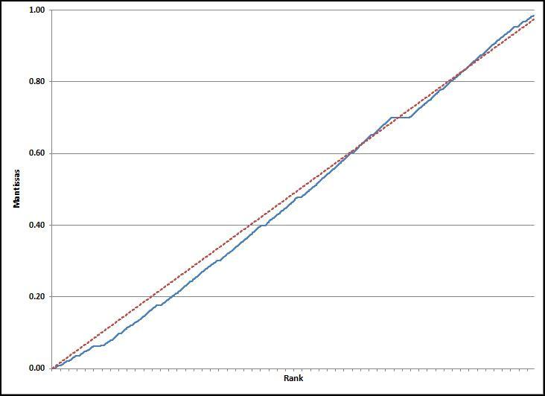
ordered mantissas
Notes:
Pages 119 to 121.
Figure 6.7.
The fractional parts of the logs will form a straight line from bottom left to top right if the data conforms to Benford’s Law. We can see that this is not the case for the invoices paid data.

Slide 9
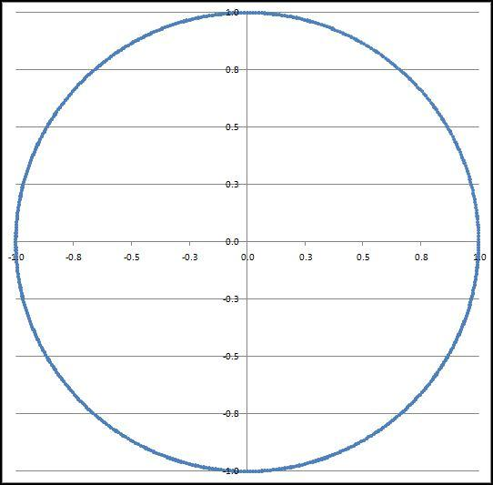
mantissa arc test
Notes:
Pages 122 to 128.
Figure 6.9.
The mantissa arc test plots the mantissas on the unit circle. If the mantissas are uniformly distributed then we would have a perfect circle with a radius of 1 and a center of gravity of (0,0). Such a result is shown above.

Slide 10
mantissa arc test
Notes:
Pages 122 to 128.
Figure 6.10.
The mantissa arc test plots the mantissas on the unit circle. If the mantissas are uniformly distributed then we would have a perfect circle with a radius of 1 and a center of gravity of (0,0). In the above case we only have numbers from 10 to 19.999 and also from 50 to 59.999.
the underlying mathematics is quite elegant but the test is too sensitive to deviations from Benford’s Law.

Slide 11
summary
Classical statistical tests only tolerate small deviations from Benford for large data sets
Z-statistic looks at one digit at a time
Chi-square & K-S look at all digits together
MAD ignores the number of records
MAD cutoff scores are based on experience
Logs are expected to form a straight line
Mantissas are expected to form a straight line
Mantissa Arc is statistically rigorous but is too sensitive to small deviations from Benford
Notes:
Page 129, and a review of the main points.

